Slide 1
Student Portfolio
STUDENT NAME :JAYASRI.R
REGISTER NO AND NMID :24132251802522017 AND
asanm225anm22524132251802522017
DEPARTMENT :B.Sc COMPUTER SCIENCE(II YEAR)
COLLEGE: COLLEGE/ UNIVERSITY:GOVERNMENT ARTS AND SCIENCE COLLEGE VANUR/ANNAMALAI UNIVERSITY.

Slide 2
PROJECT TITLE
SHOWCASING MY SKILLS AND TALENTS

Slide 3


AGENDA
Problem Statement
Project Overview
End Users
Tools and Technologies
Portfolio design and Layout
Features and Functionality
Results and Screenshots
Conclusion
Github Link
3/21/2024 Annual Review

Slide 4

PROBLEM STATEMENT
STUDENTS OFTEN STRUGGLE TO PRESENT THEIR SKILLS ,PROJECTS,AND ACHEIVEMENTS EFFECTIVELY.A DIGITAL PORTFOLIO HELPS TO SHOWCASE THEM IN A PROFESSIONAL AND ORGANIZED WAY.

Slide 5

PROJECT OVERVIEW
THE PROJECT IS ABOUT DEVELOPING A STUDENT PORTFOLIO TO SHOWCASE PERSONAL DETAILS,SKILLS,AND ACHEIVEMENTS. IT PROVIDES A SIMPLE AND PROFESSIONAL WAY TO PRESENT ACADEMIC AND PROJECT WORK.

Slide 6

WHO ARE THE END USERS?
STUDENTS-TO SHOWCASE THEIR SKILLS,PROJECTS,AND ACHEIVEMENTS.
TEACHERS/MENTORS-TO EVALUATE STUDENT PROGRESS AND WORKS.
RECRUITERS/EMPLOYERS-TO VIEW STUDENT PROFILES FOR OPPORTUNITIES.

Slide 7

TOOLS AND TECHNIQUES
HTML,CSS,JAVASCRIPT-FOR WEBSITE DESIGN AND DEVELOPMENT.
GITHUB-FOR NOSTING AND VERSION CONTROL

Slide 8
PORTFOLIO DESIGN AND LAYOUT
1.SIMPLE,CLEAN,AND USER-FRIENDLY INTERFACE.
2.SECTIONS FOR ABOUT ME,SKILLS,EDUCATION,PROJECTS,AND CONTACT.
3.RESPONSIVE DESIGN FOR MOBILE AND DESKTOP.
4.ATTRACTIVE COLORS,FONTS,AND VISUALS FOR BETTER PRESENTATION.
8

Slide 9
FEATURES AND FUNCTIONALITY
1.DISPLAYS PERSONAL DETAILS,SKILLS,AND ACHEIVEMENTS.
2.SHOWCASE ACADEMIC PROJECTS AND WORKS.
3.EASY NAVIGATION WITH RESPONSIVE DESIGN.
4.CONTACT SECTION FOR COMMUNICATION.

Slide 10
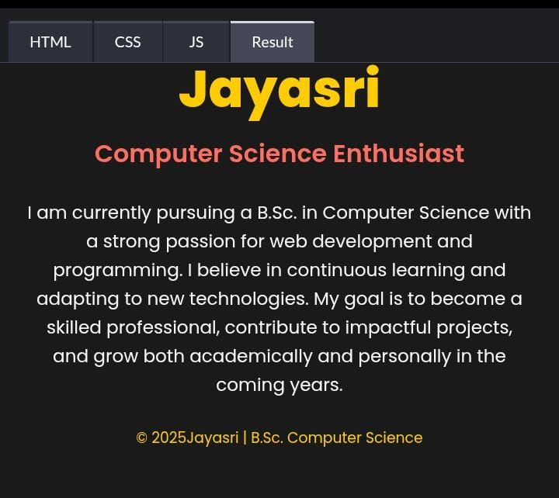

RESULTS AND SCREENSHOTS
3/21/2024 Annual Review
10

Slide 11
GITHUB
https://github.com/Jayasri456/Jayasri-TNSDC-FWD-DP

Slide 12
CONCLUSION
THE STUDENT PORTFOLIO PROVIDE A PROFESSIONAL PLATFORM TO SHOWCASE SKILLS,PROJECTS,AND ACHEIVEMENTS IN AN ORGANIZED WAY.IT HELPS STUDENTS PRESENT THEMSELVES EFFECTIVELY TO TEACHERS,PEERS,AND RECRUITERS.
12

